Slide 1
Enzymes II
Dr. Wasanthi Subasinghe

Slide 2
Objectives
At the end of this lecture you should be able to,
Explain different types of inhibition giving examples
Explain the mechanisms of regulation of enzyme activity

Slide 3
Enzyme Inhibitors
Substances that reduce or stop the enzymatic reactions and thereby interfere with catalytic activity
Inhibitors are ,
usually specific and they work at low concentrations
block the enzyme but they do not usually destroy it
The most important pharmaceutical agents and common poisons are inhibitors.

Slide 4
The effect of enzyme inhibition
a. Irreversible
Inhibitor binds covalently with the enzyme
Dilution of EI complex does not recover enzyme activity
Eg: nerve gases and pesticides

Slide 5
The effect of enzyme inhibition
b. Reversible
Inhibitor binds non covalently with the enzyme
Dilution of EI complex dissociate reversibly bound inhibitor and recover enzyme activity
1. Competitive inhibition
2. Noncompetitive inhibition

Slide 6
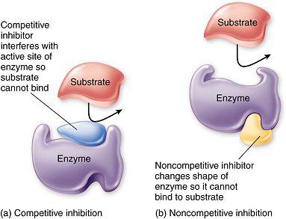
1. Competitive inhibition
Inhibitor binds reversibly to the active site [compete with substrate]
resembles substrate structure
Can overcome by ↑ Substrate concentration

Slide 7
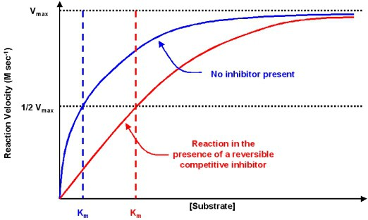
1. Competitive inhibition
Does not affect V_{max}
Increases K_{M}
(↓ enzyme’s apparent affinity for substrate)

Slide 8
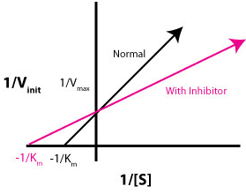
1. Competitive inhibition
Effect on Lineweaver-Burk plot
With inhibitor
No inhibitor

Slide 9
Competitive inhibitors are effective chemotherapeutic agents
Sulfa Drug (Sulfanilamide)
Substrate analogue of Para-aminobenzoic acid PABA : Inhibit folic acid (B₉) synthesis in bacteria
Methotrixate
Substrate analogue of Dihydrofolate
dihydrofolate →→→ →→→ THF
Statin drug [Atorvstatin [Lipitor] and Simvastatin]
Substrate analogue of HMG Co A
HMG CoA →→→ →→→ Cholesterol
Dihydrofolate reductase
HMG Co A reductase
Notes:
Tetrahydrofolate needs for biosynthesis of pyrimidine nucleotides, Dihydrofolate reductase

Slide 10
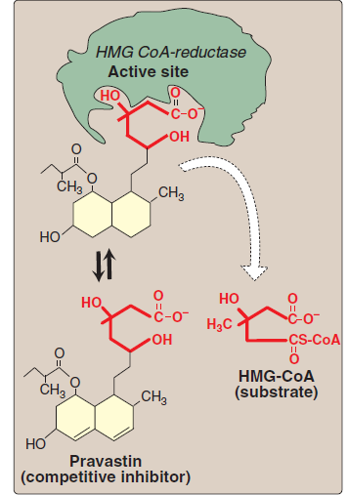
Hydroxymethylglutaryl-CoA reductase : 1st commited step of cholesterol synthesis : Inhibit de novo synthesis

Slide 11
2. Noncompetitive Inhibition
Inhibitor binds at site other than active site.
No Structural resemble to substrate
Affect on catalytic activity of the enzyme
Inhibitor

Slide 12
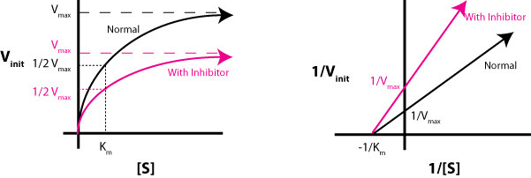
2. Noncompetitive Inhibition
When inhibitor concentration is increased
1. V_{max} → decrease : Characteristic
2. K_{m} → No change
Notes:
Eg: Ferrochelatase (Heme synthesis en) inhibited by lead

Slide 13
Enzyme Regulation
[S] (substrate level regulation)
pH, salt (various ions)
Inhibitors (presence and concentration)
Allosteric modification
Covalent modification
Induction and suppression of enzyme synthesis
Production of enzyme as Zymogen form
Compartmentalization of enzymes

Slide 14
1. Allosteric Regulation
Enzymes that undergoes allosteric regulation are called allosteric enzymes or regulatory enzymes
Generally are multi-subunit, large enzyme complexes.
Regulation is brought about by non- covalent changes in enzyme molecule
Active site
Contains two sites
1. Allosteric site
-modulator binding site
2. Active site
-substrate binding site
E
allosteric site

Slide 15
1. Allosteric Regulation
The binding of modulator/ effectors molecules to one regulatory site changes the 3-D conformation, which alters the affinity of enzyme towards substrate.
Stimulatory effect
+ modulators
Modulator
- modulators
Inhibitory effect
Homotropic effectors : Substrate itself
Heterotropic effectors: Different from substrate

Slide 16
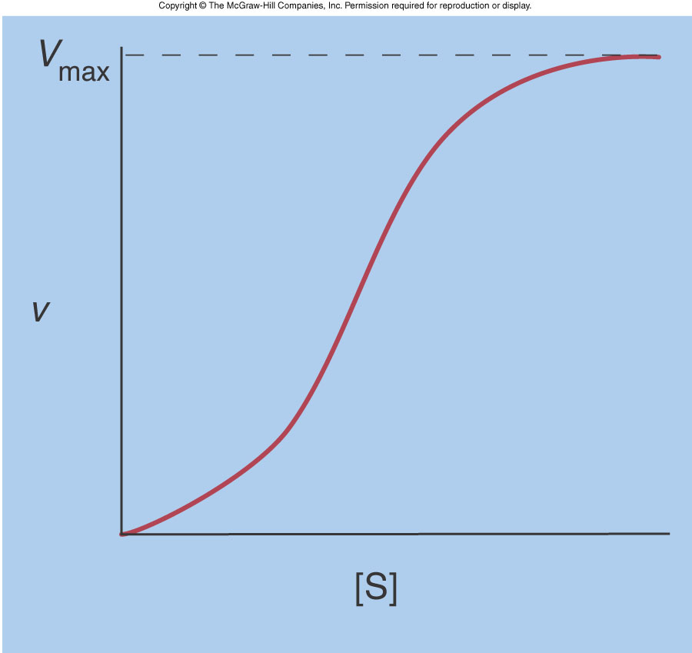
1. Allosteric Regulation
Do not obey Michaelis-Menten kinetics
Plot of V_{o} vs. [S] is sigmoidal
+
_

Slide 17
Allosteric Enzyme Regulation Feedback inhibition
The first step (controlled by e_{A}) is often controlled by the end product (F)
Therefore negative feedback is possible
A B C D E F
e_{A}
e_{B}
e_{C}
e_{D}
e_{F}
Inhibition
The end products are controlling their own rate of production
There is no build up of intermediates (B, C, D and E)
Notes:
PFK1 inhibited by citrate

Slide 18
2. Covalent modification of enzymes
Phosphorylation/dephosphorylation
Eg: Glycogen Metabolism
Synthesis of glycogen : glycogen synthase
Breakdown of glycogen: glycogen phosphorylase
Phosphorylated Glycogen synthase inactive
Phosphorylated Glycogen phosphorylase active
Notes:
Phosphorylation : Protein kinases and Dephosphorylation: Protein phosphatase

Slide 19
Enzyme Regulation
Regulation by regulate the availability of enzyme
Induction or repression of En synthesis
Production of enzyme as Zymogen form
Compartmentalization of enzymes
by moderating rate determining step

Slide 20
Induction or repression of En synthesis
Eg : High blood Glu → Insulin secretion → Induction of glycolytic enzymes
Slow (hours to days)
Production of enzyme as Zymogen
zymogen (proenzyme) : an inactive enzyme precursor.
Pepsinogen, Trypsinogen

Slide 21
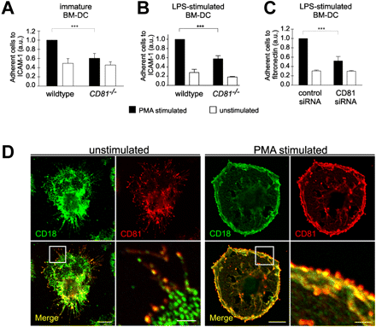
Phagocytic like NADPH oxidase

